Slide 1
Super Duper Tic-Tac-Toe
Daniela Martignani
Peter Miele
Jennifer Shaska

Slide 2
Technologies
Java Springboot
spring-boot-starter-web
spring-boot-starter-data-mongodb
WebGL
Node.js
Socket.io
Socket.io-cookies
Apache Tomcat
Servlets
JSPs
MongoDB

Slide 3
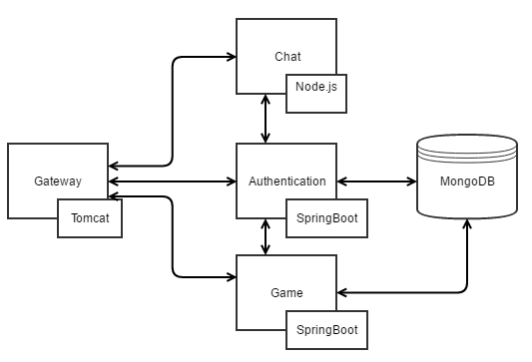
Architecture

Slide 4
Chat

Slide 5
WebGL
Web Graphics Library: a JavaScript API for rendering interactive 2D and 3D computer graphics within any compatible web browser without the use of plug-ins.
Two parts:
JavaScript control code
Shader code executed in the GPU: removes rendering bottleneck

Slide 6

WebGL
(0.0, 0.0, 0.0)
Perspective and graphics
(x, y, z)
(-3.5, 3.5, -12.0)
(0.0, 0.0, -10.0)
(0.0, 0.0, -12.0)

Slide 7
Demo

Slide 8
Takeaways
Starting with a small scope for the project let us accomplish what we initially set out to do
We each specialized into different technologies and then shared
The Subway at the Oakland Center is the only food available on weekends on campus
Scrum did not work well for the limited time of the project and the overlapping hours that we could work together
Tracking the separation of concerns and functionality of various microservices can be complicated and takes some time to adjust to

Slide 9
Potential Improvements
Add a means to export a RDF using FOAF that describes the users of our system identified by email and link them to the games in which they have played
The ability to pick your shape and color for playing the game
The ability to play other games, like connect 4
Improved UI

